Slide 1

Telecom Churn Prediction Model: Maximizing Profitability through Data Mining & ML
Ashmy Josy: u2247447
Ikram :u2080332
Ramya Panchatcharam : u2083209
Sharmila Shrestha : u1966188

Slide 2
Table of contents
Introduction
Data wrangling
Dataset background and objective
Data Cleaning and
Justification
Exploratory Data analysis
Research questions and data depiction
Implementation
Summary
Results and Deployment
Model design and
optimization
Models' evaluation and user interface

Slide 3

01.
Introduction

Slide 4

Introduction
The telecommunications industry is experiencing rapid growth and intense competition, necessitating a focus on customer retention.
Customer churn, the loss of subscribers, poses a significant challenge to telecom companies.
This presentation explores the application of data mining and machine learning techniques for predicting customer churn.

Slide 5
Our Objective
Develop a customer churn prediction model tailored for the telecommunication industry.
Utilize data mining techniques and machine learning algorithms to predict which customers are likely to churn.
Enable telecommunication companies to implement proactive retention strategies, thereby minimizing churn and maximizing profitability.
To deploy an interactive user interface with the algorithm implemented.
Our Research Questions

Slide 6

Dataset
Source
The dataset was sourced from Kaggle, a well-known platform for data science competitions and datasets
Selection
The dataset offers insights into factors influencing churn, by leveraging this dataset, we can address the specific challenges and dynamics of the telecommunication industry, enhancing the relevance and applicability of our predictive analysis.
Overview
The dataset provides comprehensive information on customer behaviors, usage patterns, demographics, and subscription details. It includes historical churn data, allowing for the training and evaluation of predictive models.

Slide 7
02.
Data Cleaning and Justification

Slide 8
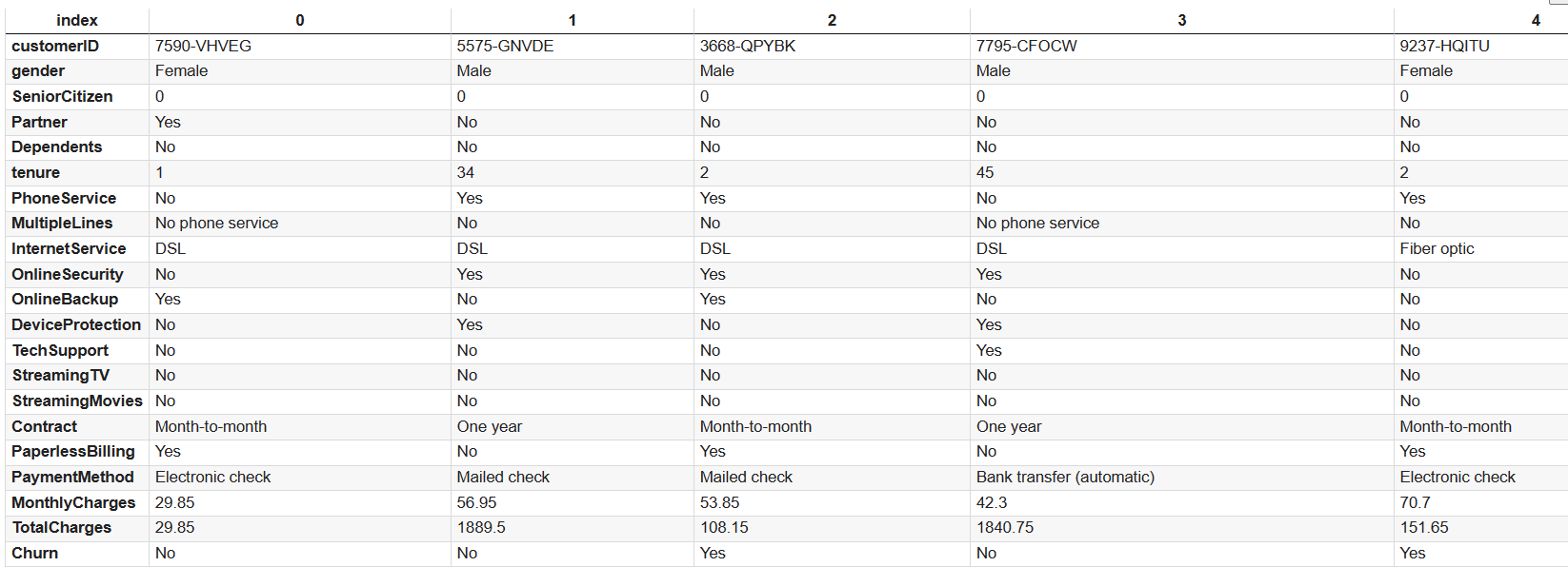
Loading the Data
Research new markets
Innovative solutions
Analyze existing customer needs and identify gaps in the market to find new opportunities
Utilize technology and customer feedback to come up with novel solutions that meet your customer’s demands or needs
Seasonal spikes
Monitor changes in the marketplace, such as shifts in consumer behavior or emerging technologies, to stay competitive and capitalize on new opportunities and trends
Identify times of year when demand for certain products may spike, such as holidays or special occasions, and use these times to target customers or maximize sales
Stay ahead of trends

Slide 9
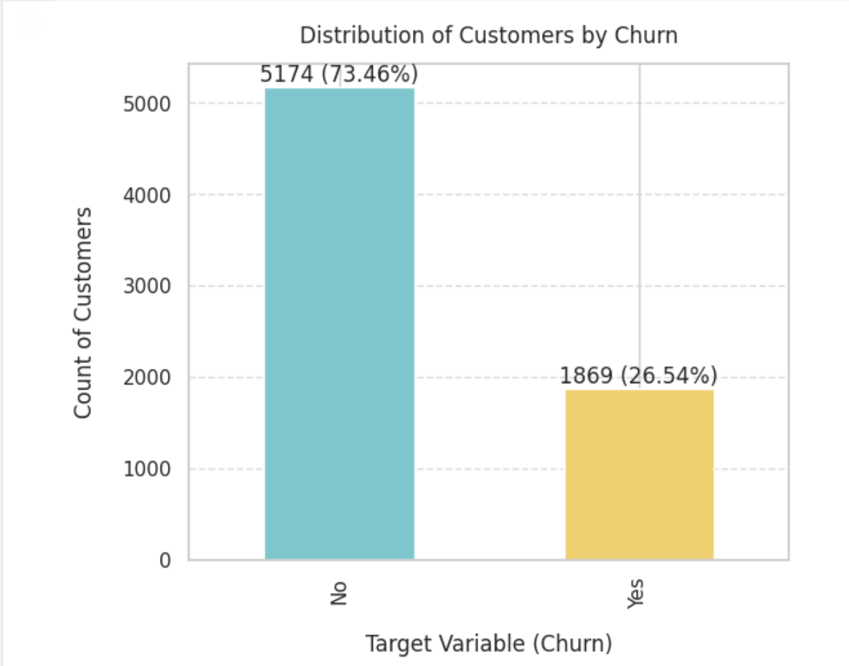
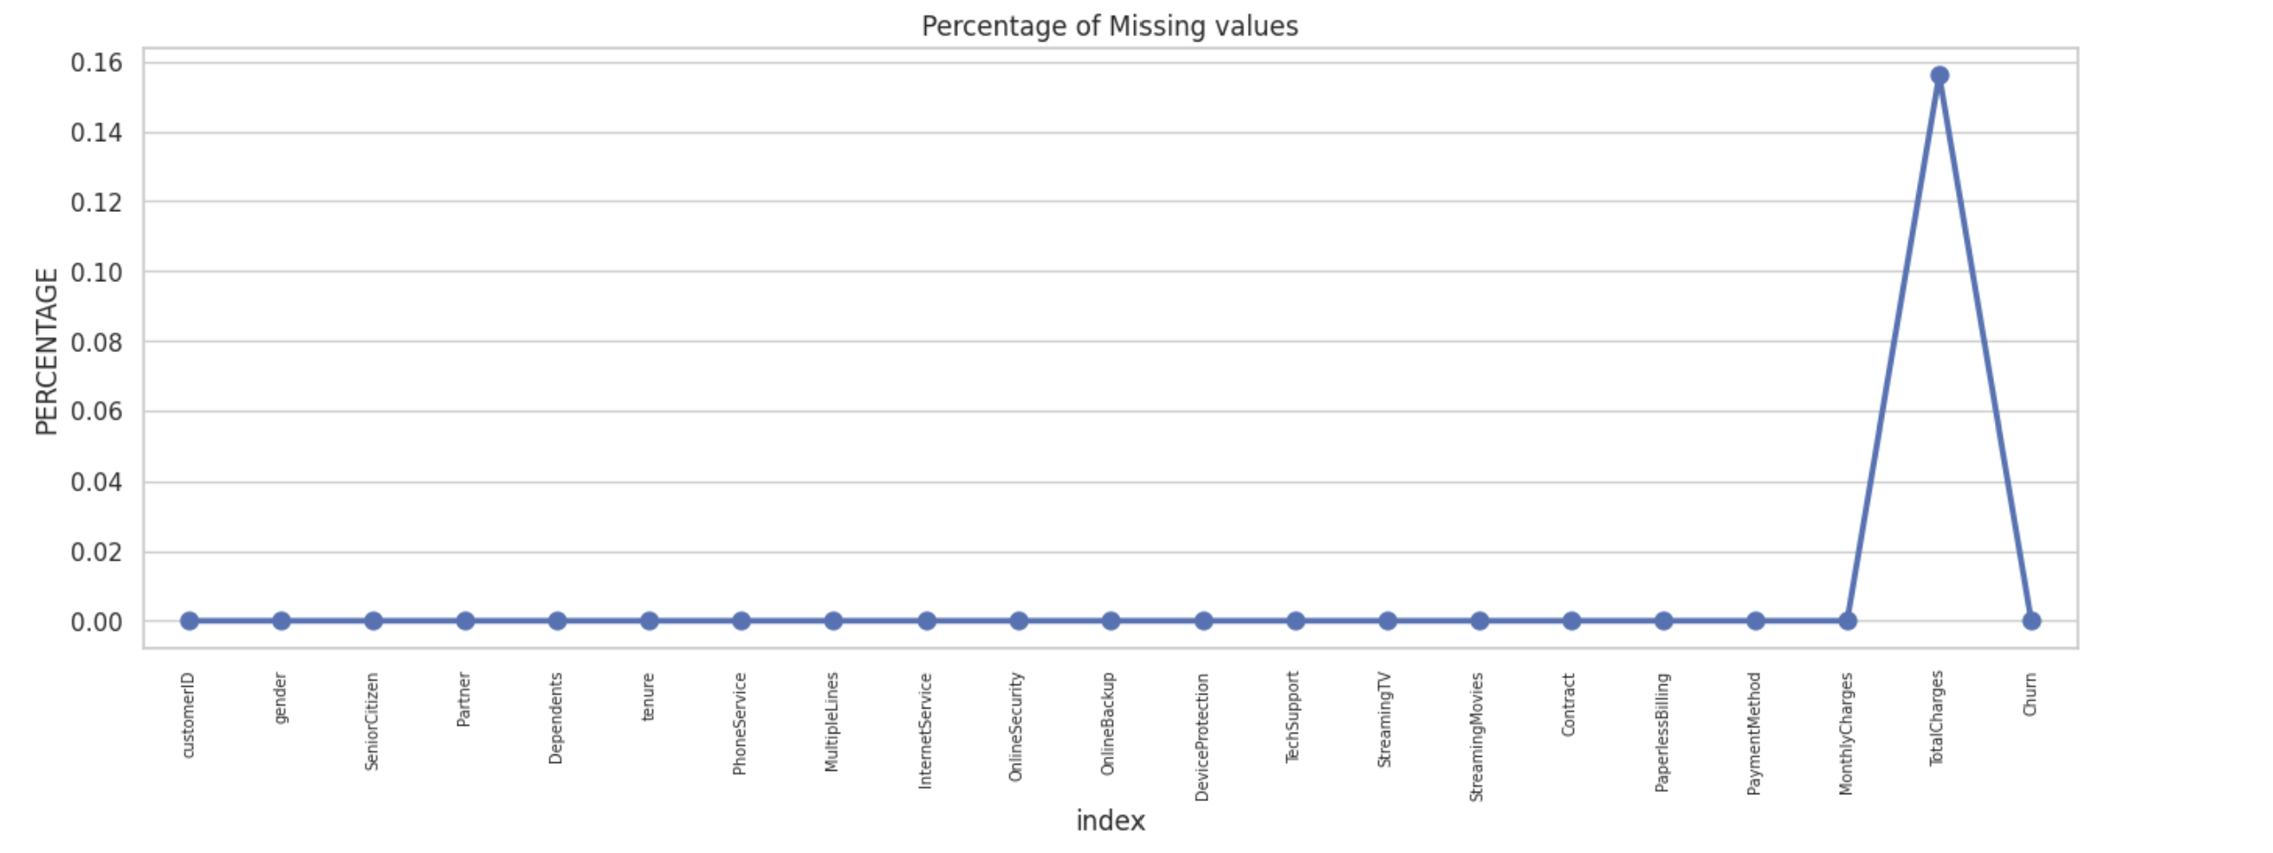
Data imbalance and the missing values

Slide 10
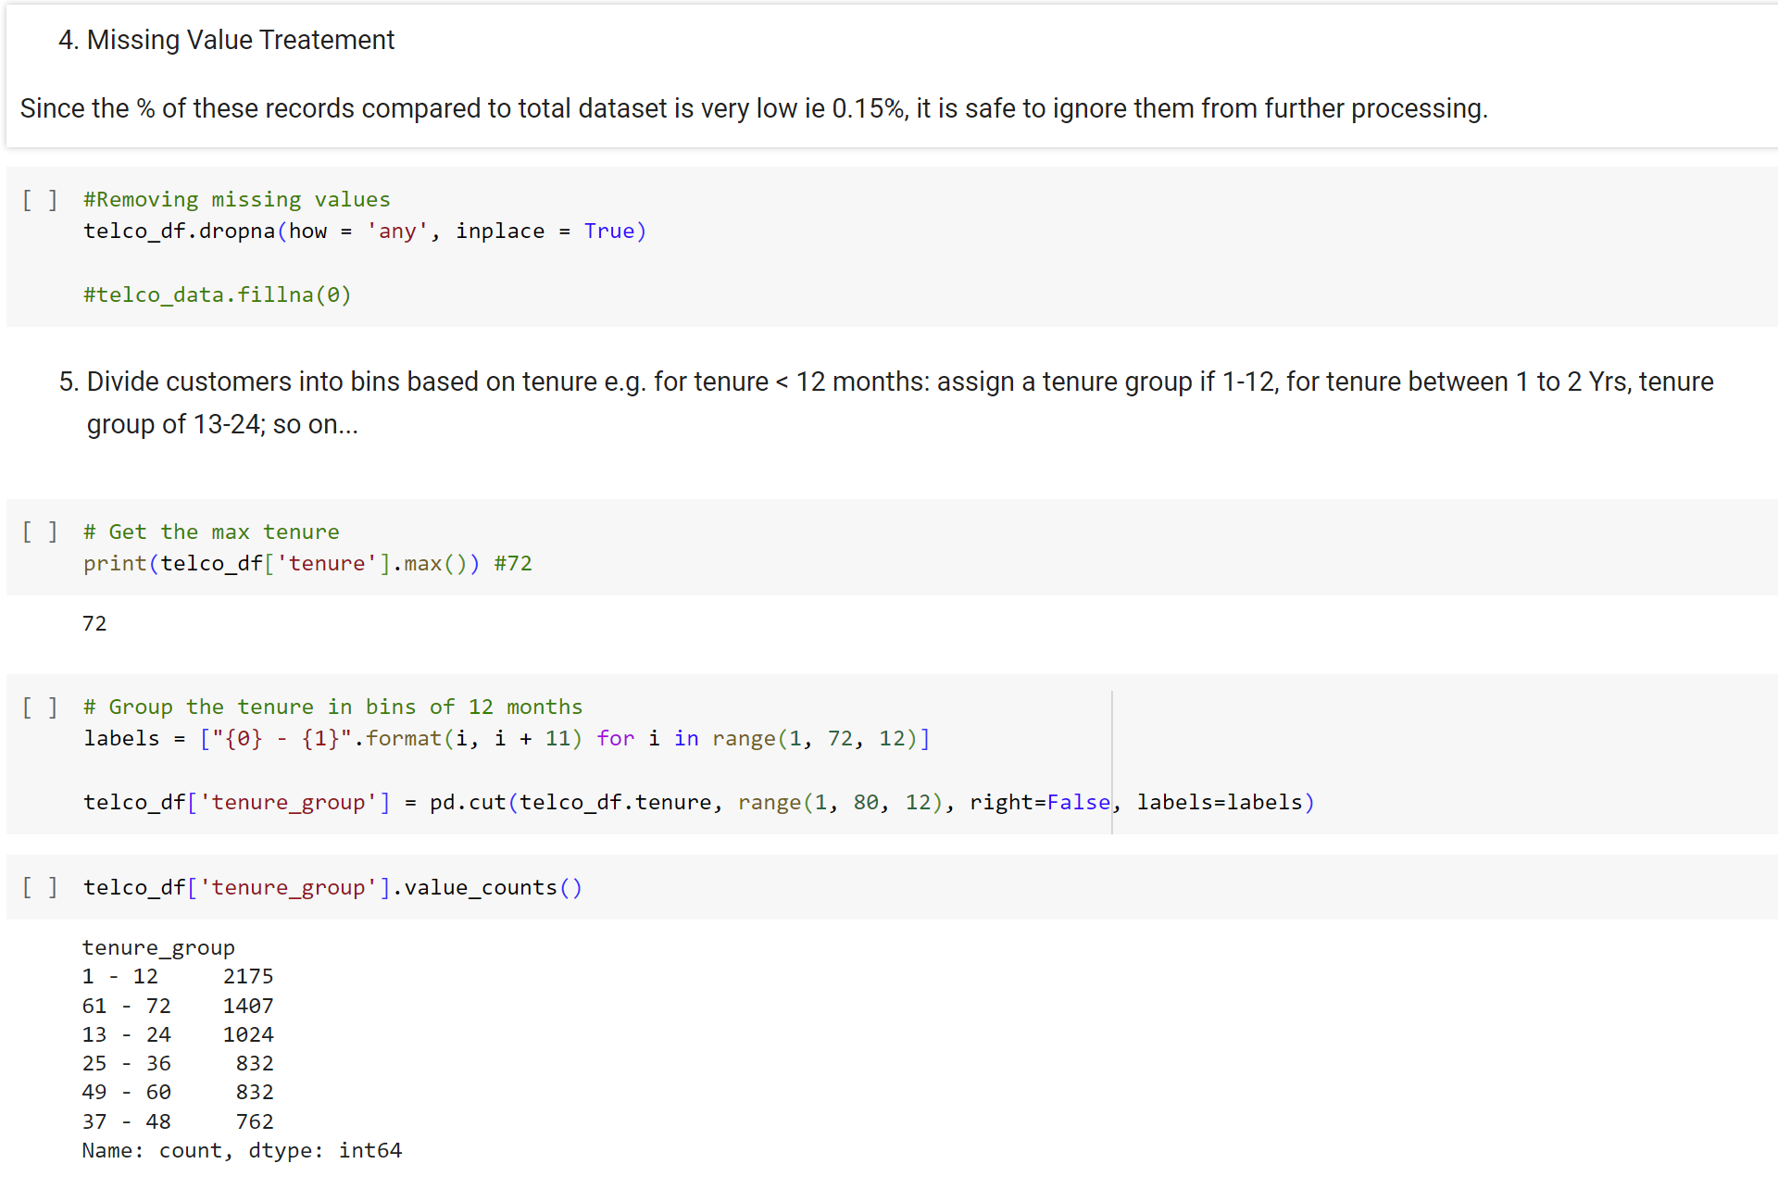
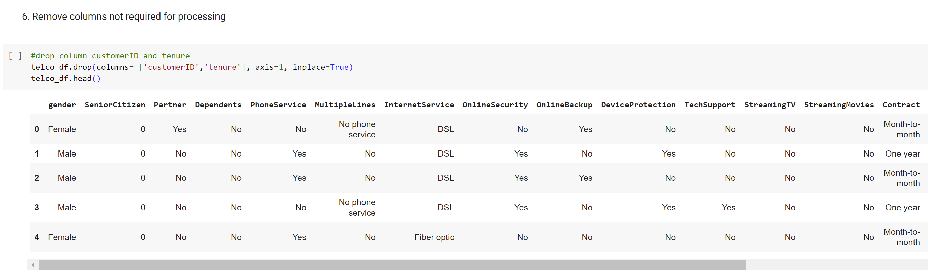
Handling missing values and unnecessary columns

Slide 11
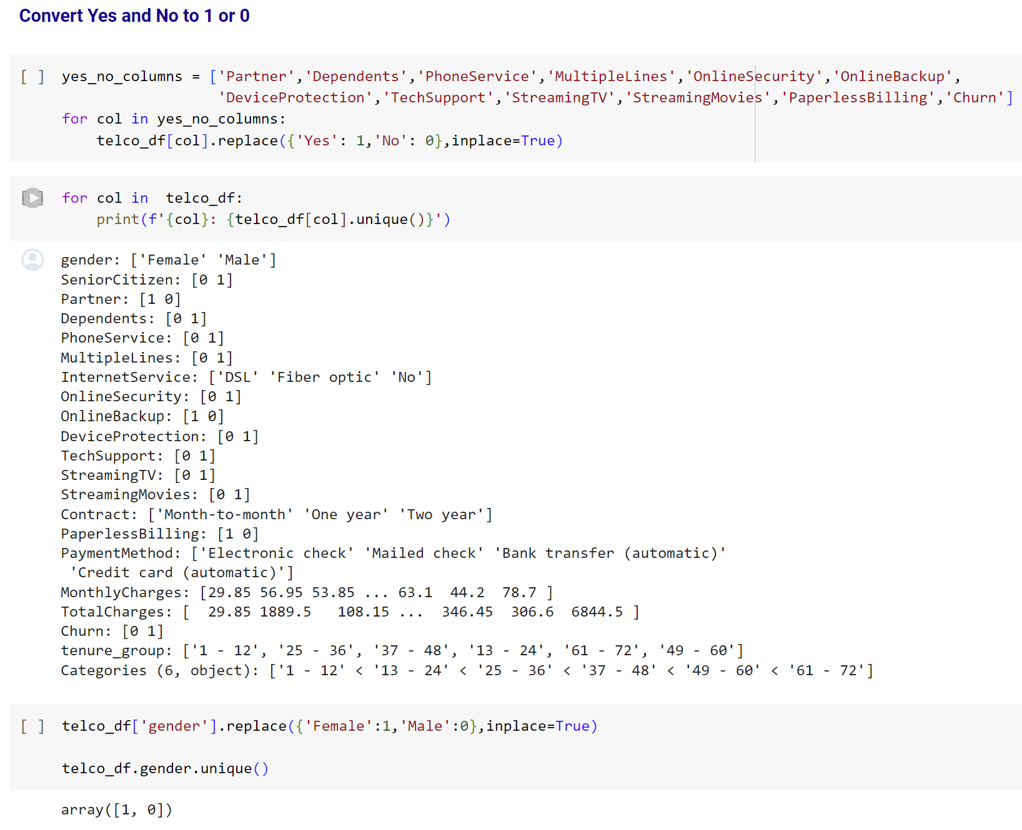
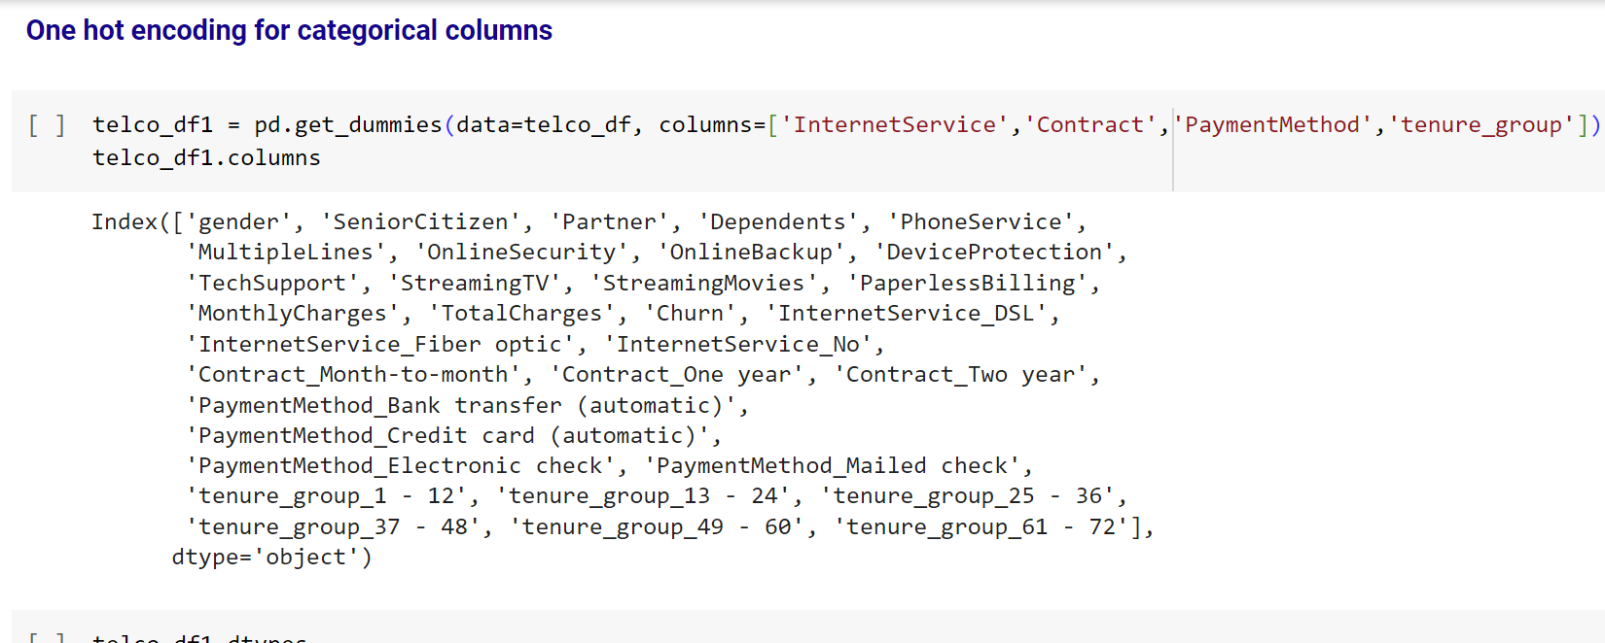
Converting string values and one hot encoding

Slide 12
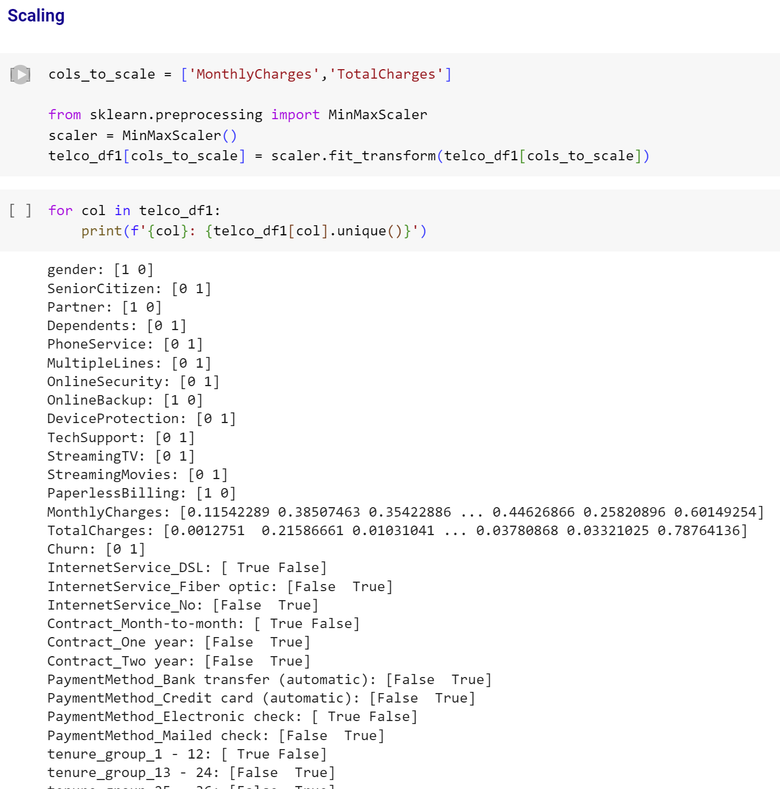
Scaling

Slide 13
03.
Exploratory Data analysis

Slide 14
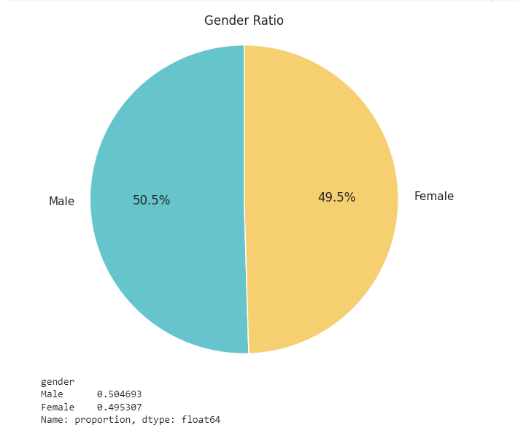
1. What is the ratio between males and females in the company?

Slide 15
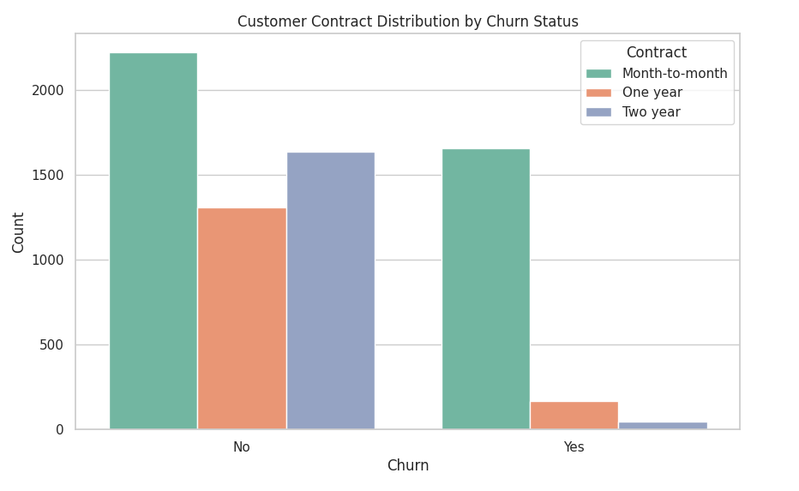
2. How does the distribution of customer contracts vary between churned and non-churned customers?

Slide 16
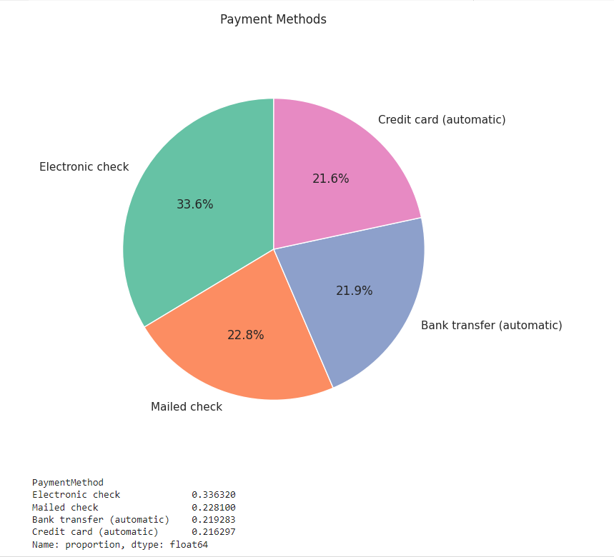
3. How many payment methods do we provide? And what is the ratio between each other?

Slide 17
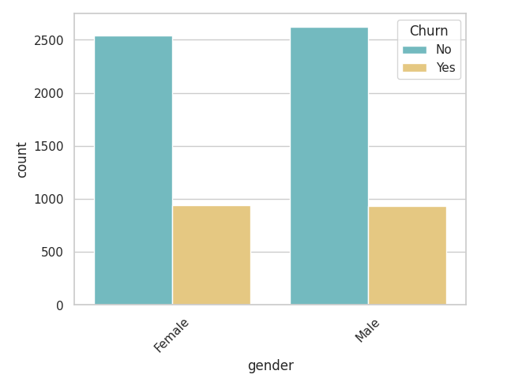
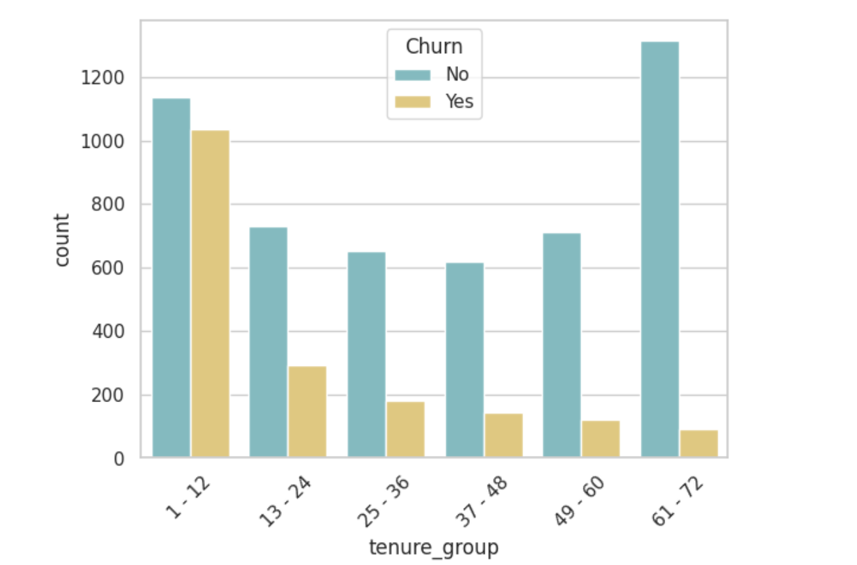
4. Analyze the correlation between all customer attributes (predictors) and the churn target variable. (This can help identify potentially relevant features for the model)

Slide 18
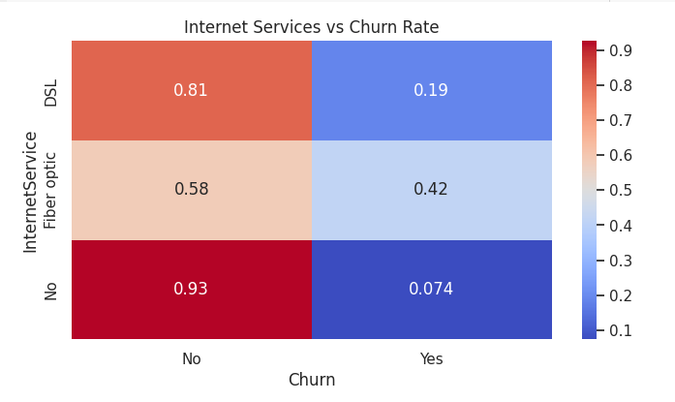
5. What is the impact of different internet service types on customer churn rates?

Slide 19
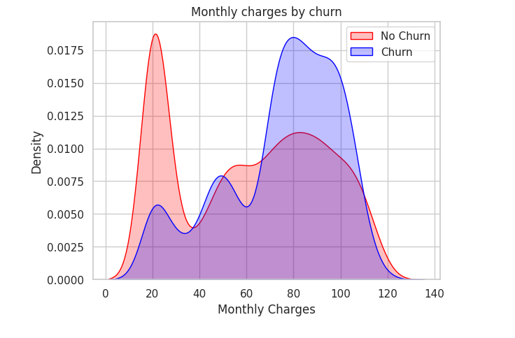
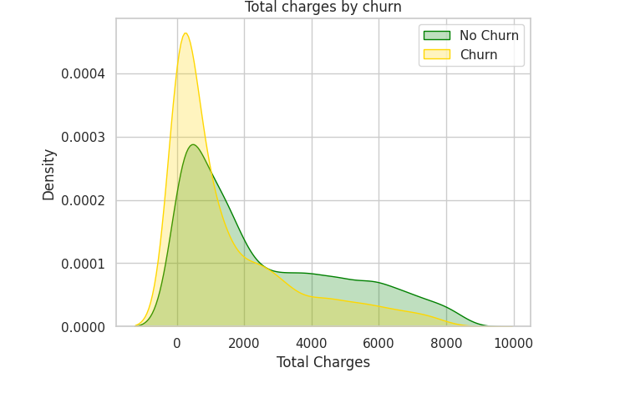
6. Churn by Monthly Charges and Total Charges

Slide 20
04.
Implementation and Results

Slide 21
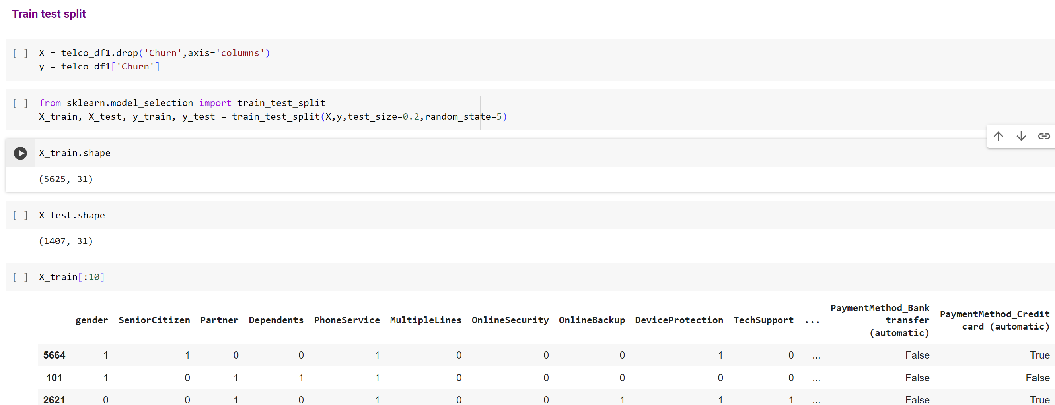
Train and test split

Slide 22
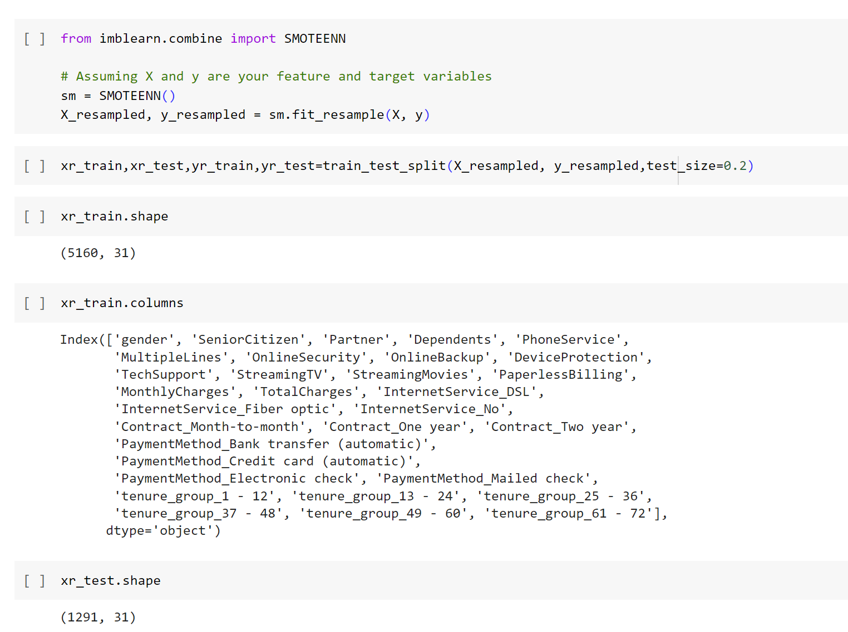
Smote method
Imbalance Correction:
SMOTE(Synthetic Minority Oversampling Technique) addresses imbalanced datasets by generating synthetic samples for the minority class.
It enhances model accuracy by providing more balanced training data without altering the original dataset's integrity.

Slide 23
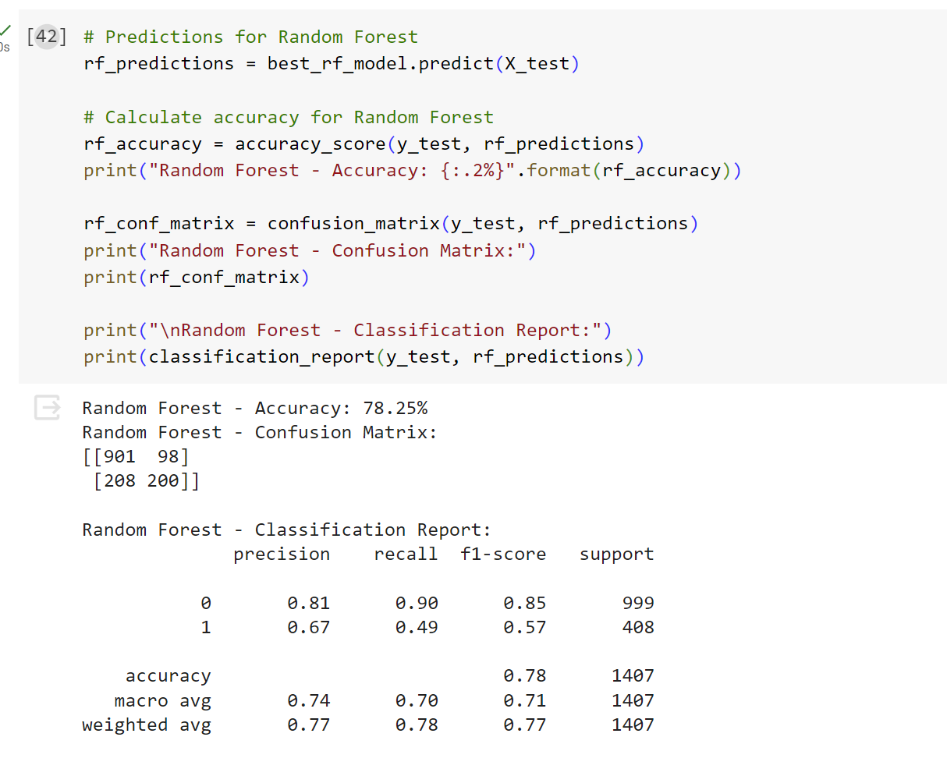
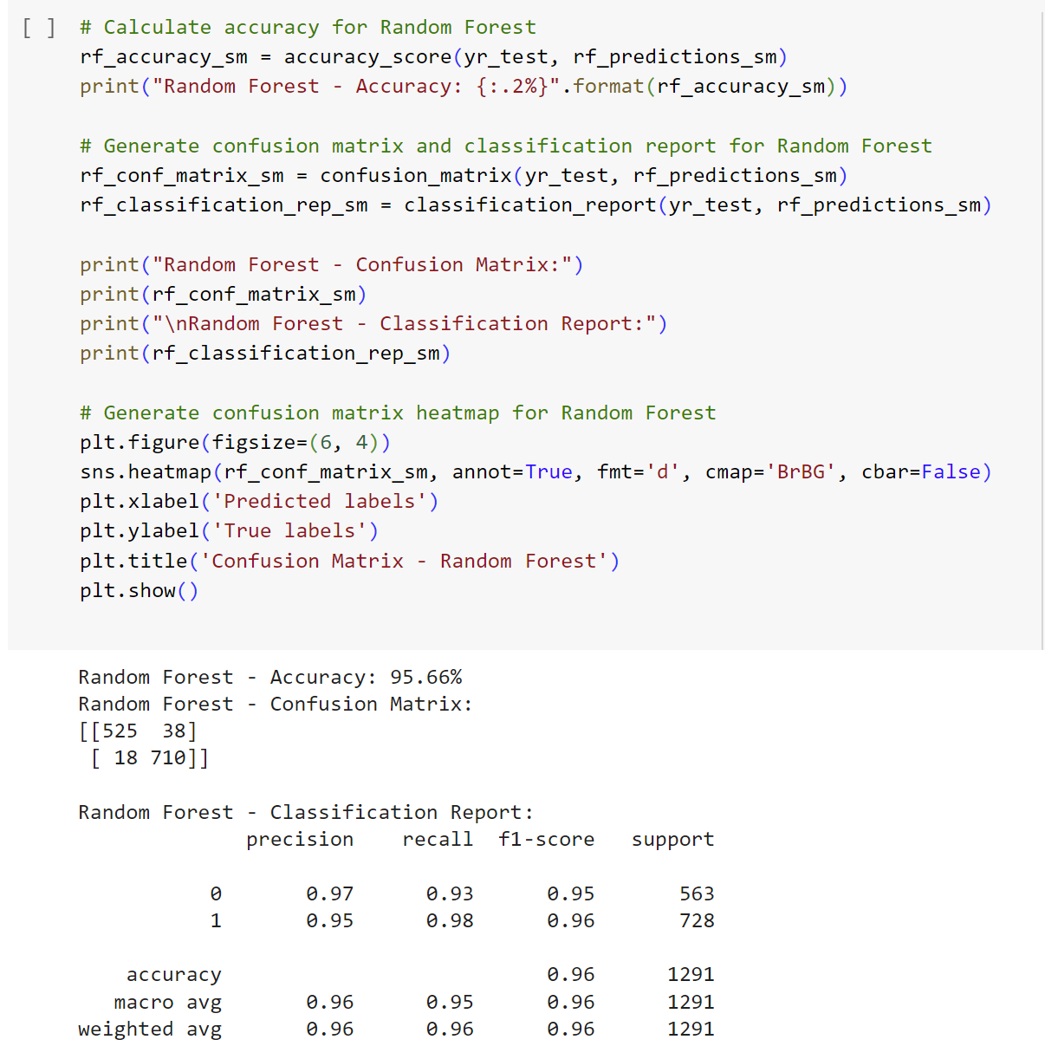
Smote method
Before
After

Slide 24
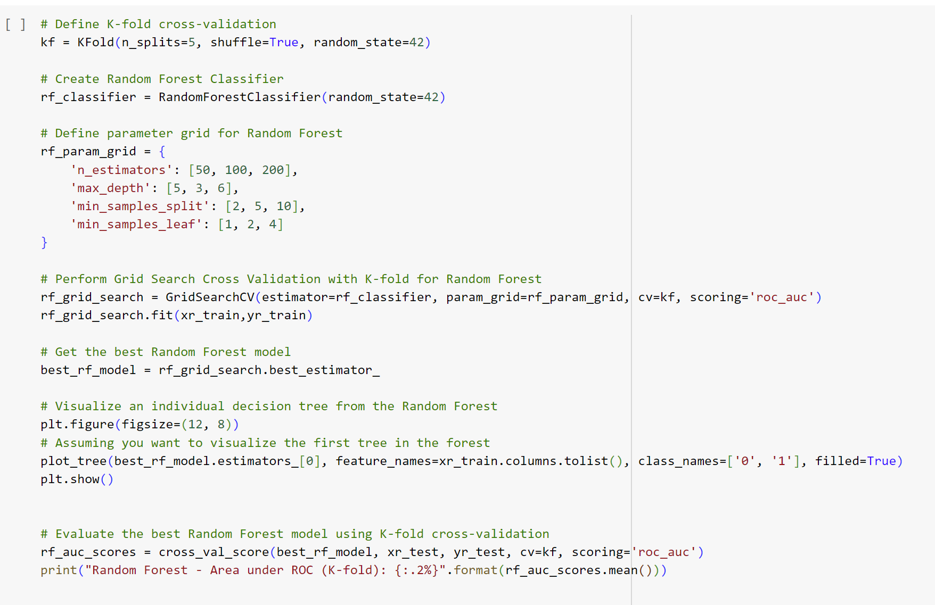
1st model: Random Forest
Overview:
Overview The Random Forest model is employed to predict customer churn based on various features. Configuration details include:
FeaturesCol and LabelCol: Using a set of features as the input and "churn" as the target label.
Hyperparameter Tuning with Cross-Validation is used

Slide 25
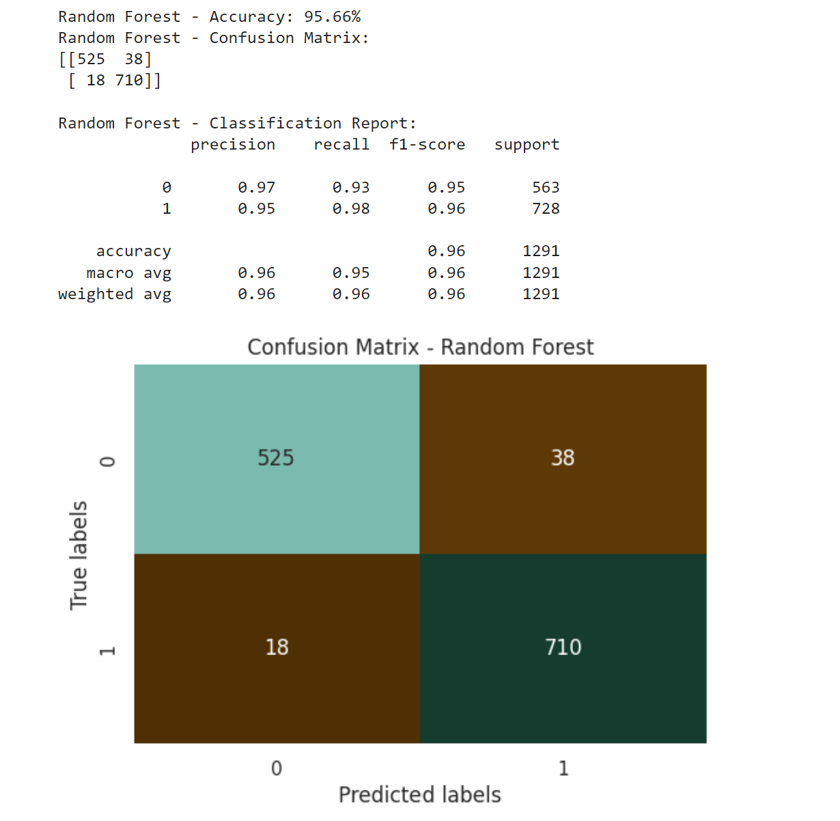
Result of the 1st model
Overview:
The Random Forest model achieved an overall accuracy of 95.66% in predicting customer churn, demonstrating strong performance. The confusion matrix highlights 538 true negatives and 698 true positives, indicating effective identification of both non-churning and churning customers

Slide 26
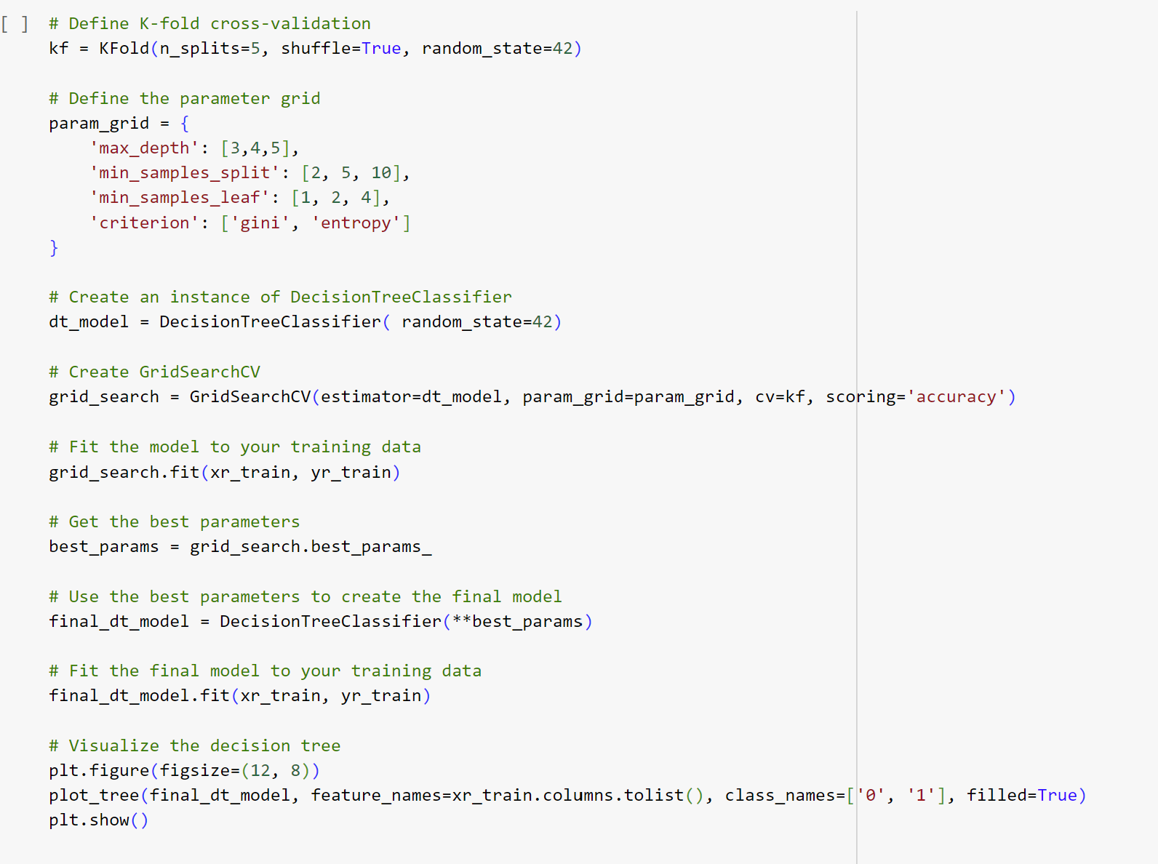
2nd model: Decision Tree
Overview:
This document describes the implementation of a Decision Tree Classifier with hyperparameter tuning using GridSearchCV.
Why Decision Tree Classifier: Interpretability, Non-linearity Handling, Feature Importance, Flexibility
The accuracy metric was used to evaluate the model's performance, measured by the Confusion matrix.

Slide 27
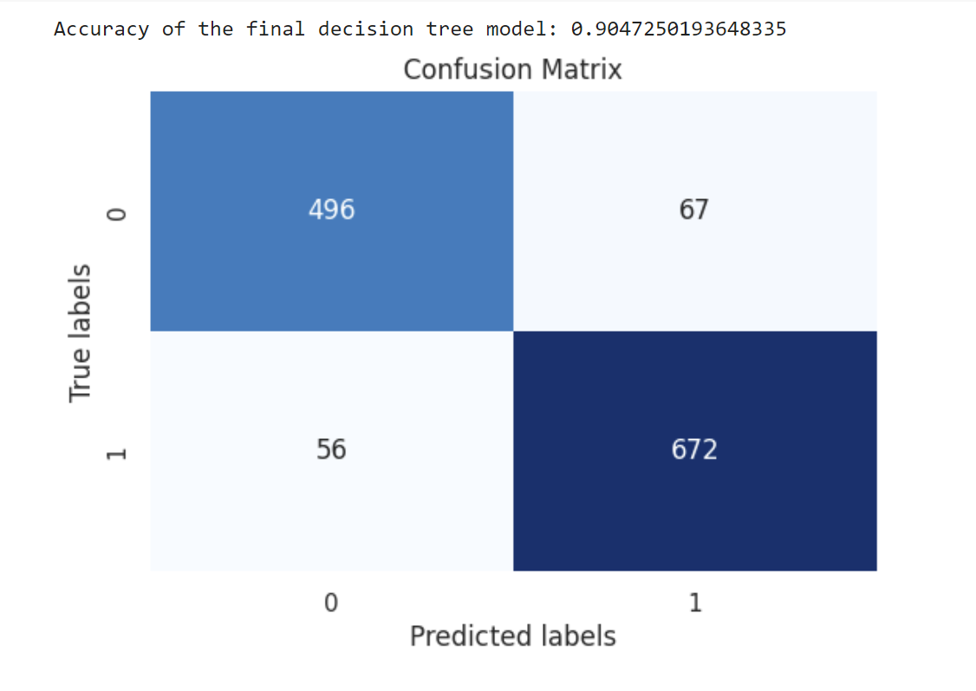
Result of the 2nd model
Overview:
The Decision Tree algorithm achieved an accuracy of 0.904 and a ROC curve of 0.97, indicating effective identification of both non-churning and churning customers

Slide 28
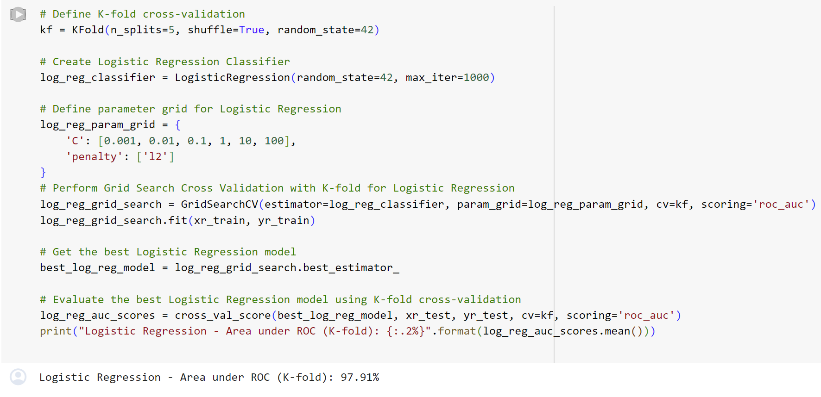
3rd model: Logistic Regression
Overview:
The Logistic Regression Classifier is a fundamental machine-learning algorithm used for binary classification tasks.
FeaturesCol and LabelCol: Using a set of features as the input and "churn" as the target label.
K-Fold Cross-Validation for Robustness
Hyperparameter Tuning with Grid Search

Slide 29
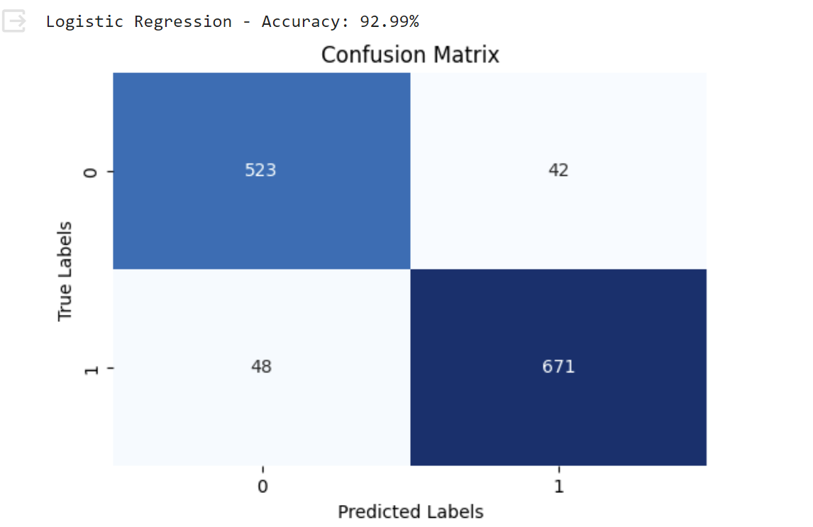
Result of the 3rd model
Overview:
The logistic regression algorithm achieved an accuracy of 92.99% and a ROC curve of 0.98, indicating effective identification of both non-churning and churning customers

Slide 30
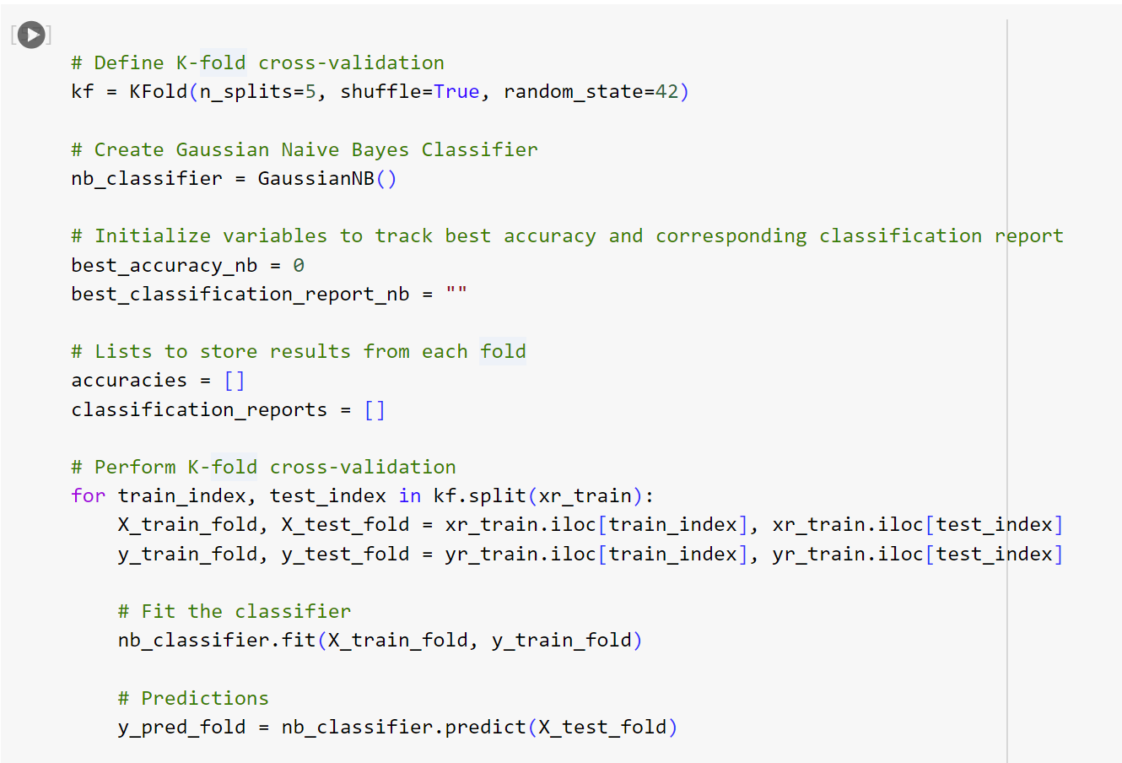
4th model: Naive Bayes
Overview:
The Naive Bayes Classifier is a fundamental machine-learning algorithm used for binary classification tasks.
FeaturesCol and LabelCol: Using a set of features as the input and "churn" as the target label.
K-Fold Cross-Validation for Robustness

Slide 31
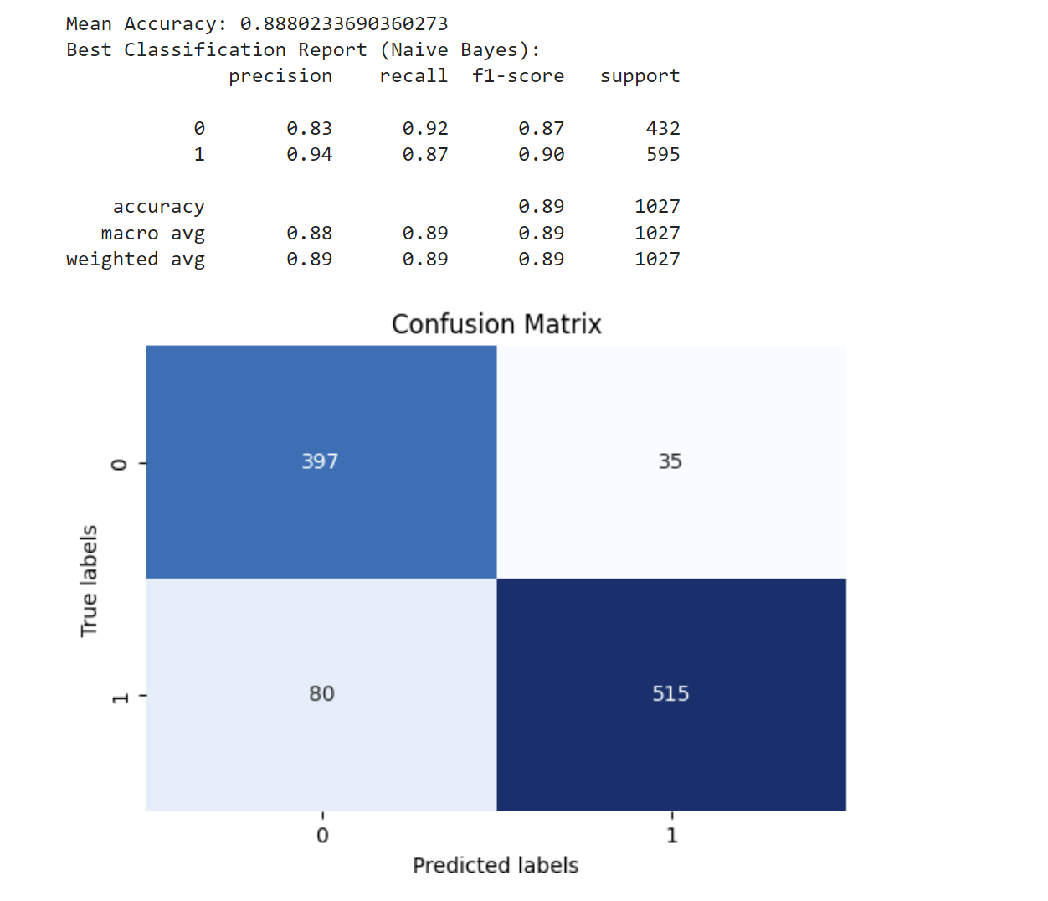
Result of the 4th model
Overview:
The logistic regression algorithm achieved an accuracy of 89% and a ROC curve of 0.96, indicating effective identification of both non-churning and churning customers

Slide 32
05.
User interface deployment

Slide 33
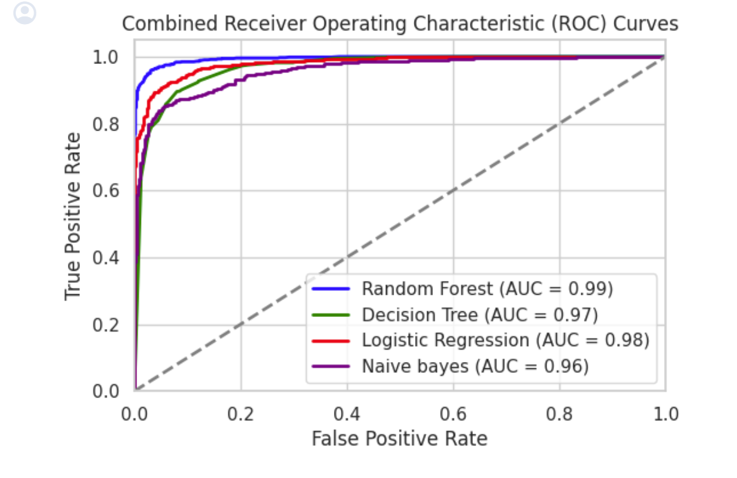
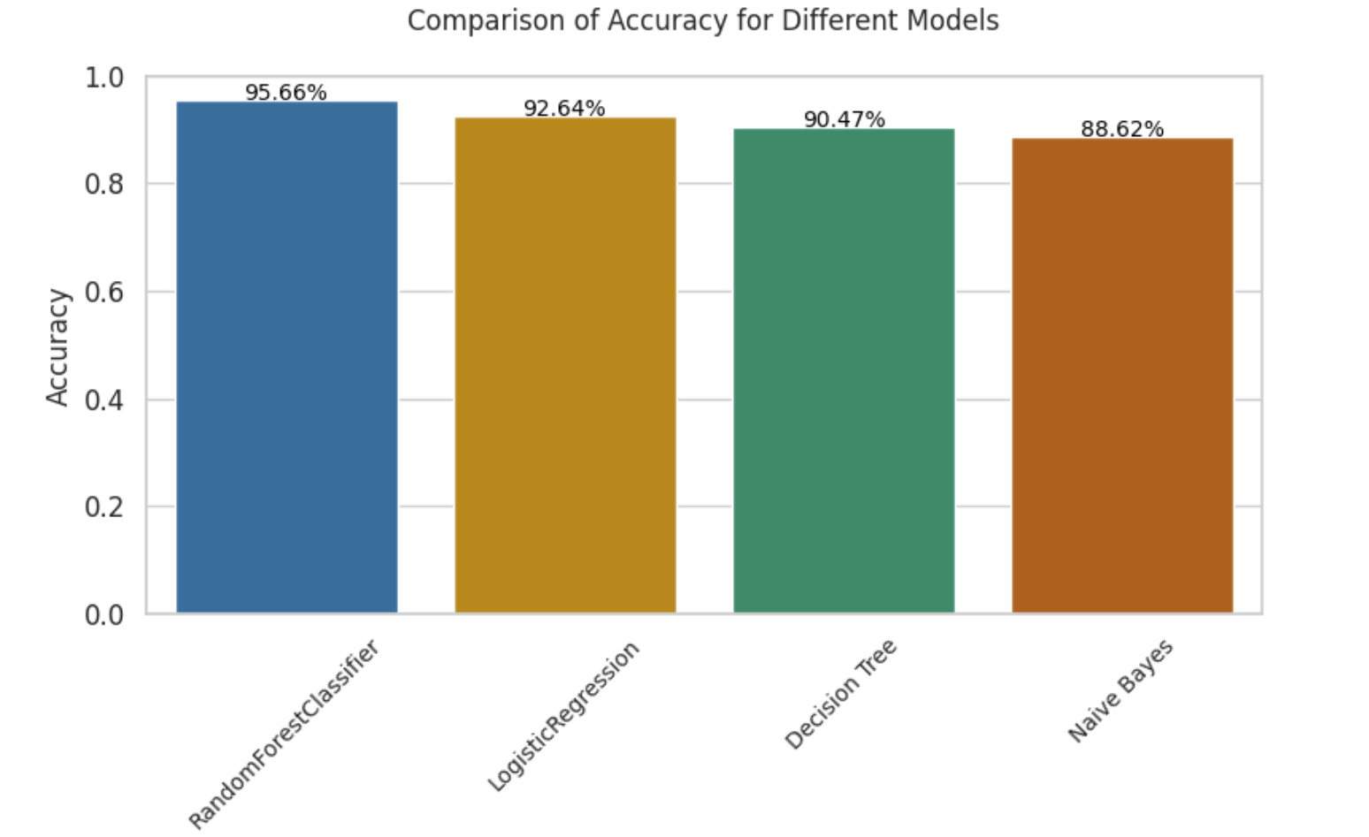
Comparison of results
Random forest classifier achieved the highest accuracy at 95.66%, followed by Logistic Regression Decision Trees at 92.64%. And then the Decision tree model with 90.47% accuracy. Naive Bayes had the lowest accuracy at 88.62%, emphasizing the trade-offs between model complexity and accuracy.

Slide 34
Summary
Developed a predictive model for telecom customer churn.
Vital for maximizing profitability amidst intense competition.
Leveraged data mining and machine learning techniques.
Compared the models to get the best one for the solution
Identified at-risk customers for effective retention strategies through research questions.
Deployed a user-friendly interface to enhance usability.
Improved solution's value and usability.

Slide 35
Thanks!
Do you have any questions?

